Slide 1
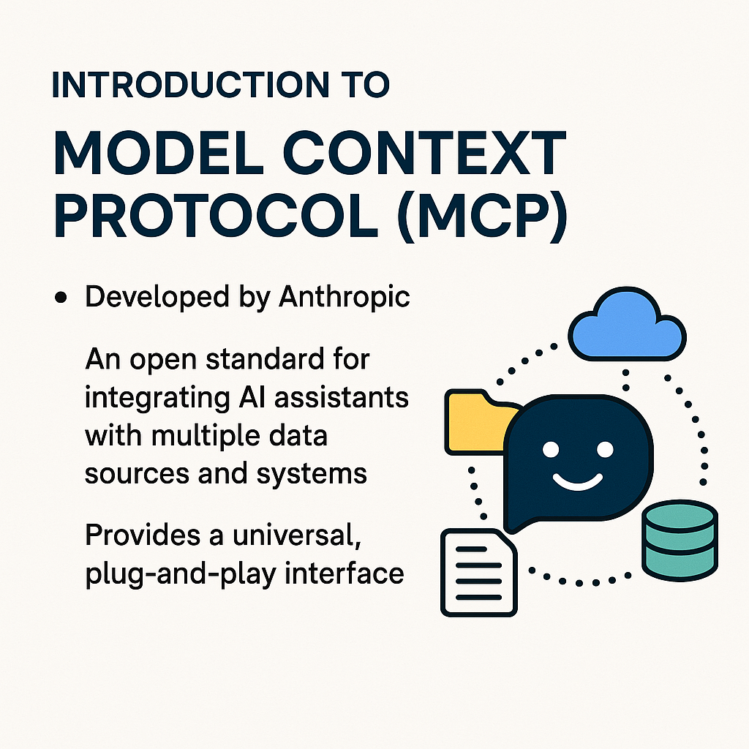
Notes:
The Model Context Protocol, or MCP, is an open standard developed by Anthropic to seamlessly integrate AI with external data, tools, and systems.
A key advantage? It provides real-time, relevant, and structured information, crucial for effective AI deployment and improved decision-making.
The MCP also prioritizes security and privacy, ensuring sensitive data protection, and its modularity allows for flexible integration across various applications.
In essence, MCP is a significant leap forward in harnessing AI's full potential while tackling data integration challenges.

Slide 2
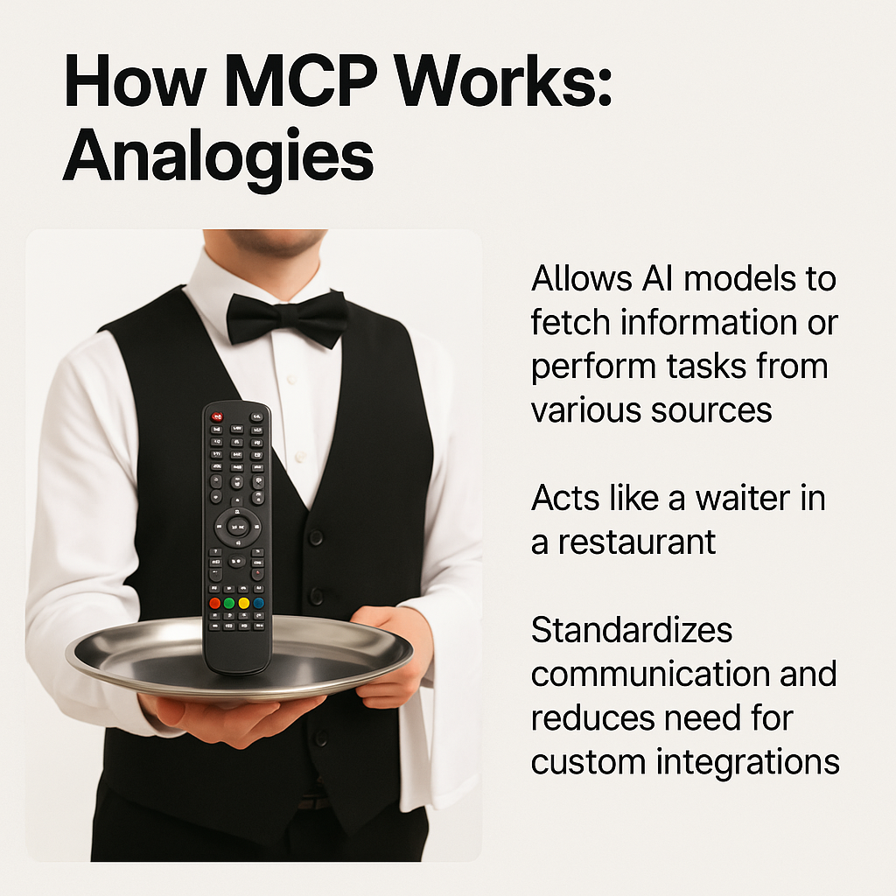
Notes:
Think of MCP as a universal remote for AI, allowing various AI models to seamlessly interact with diverse information sources and perform a multitude of tasks.
Much like a restaurant waiter, the MCP standardizes communication, simplifying development and boosting efficiency and scalability.
Essentially, transforming complex integrations into effortless interactions.

Slide 3
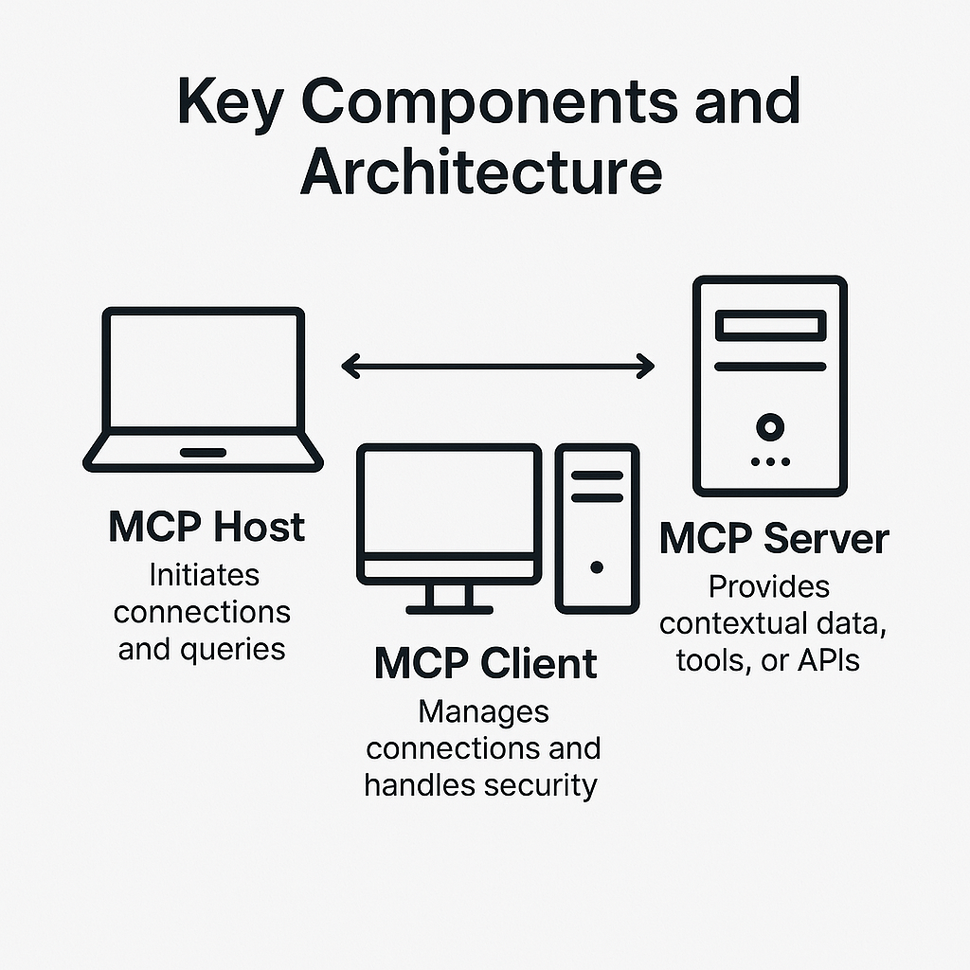
Notes:
Our system operates on a robust client-server model, powered by three core components.
First, the MCP Host initiates all connections and queries, acting as the starting point for interactions.
Next, the MCP Client manages secure connections, ensuring data integrity and seamless, reliable communication.
Finally, the MCP Server serves as the backbone, providing contextual data, tools, and APIs, responding to host queries with the information and services needed.
Together, they create a highly efficient and secure architecture, optimizing performance and reliability.

Slide 4
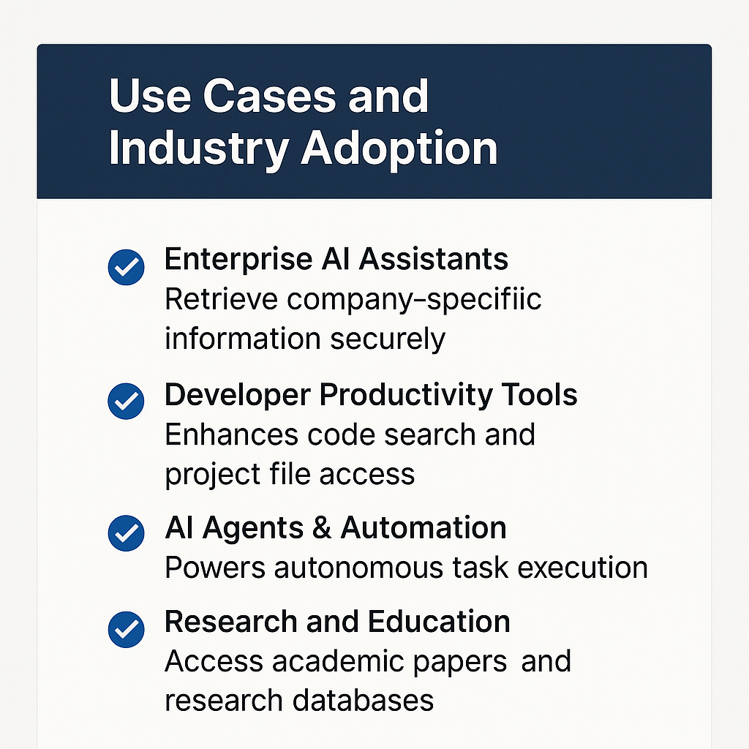
Notes:
AI is revolutionizing various sectors, with enterprise AI assistants leading the charge.
These invaluable tools securely retrieve company-specific information, granting employees quick and efficient access to data like confidential financial reports or client profiles.
This significantly boosts productivity and enhances decision-making across organizations.

Slide 5
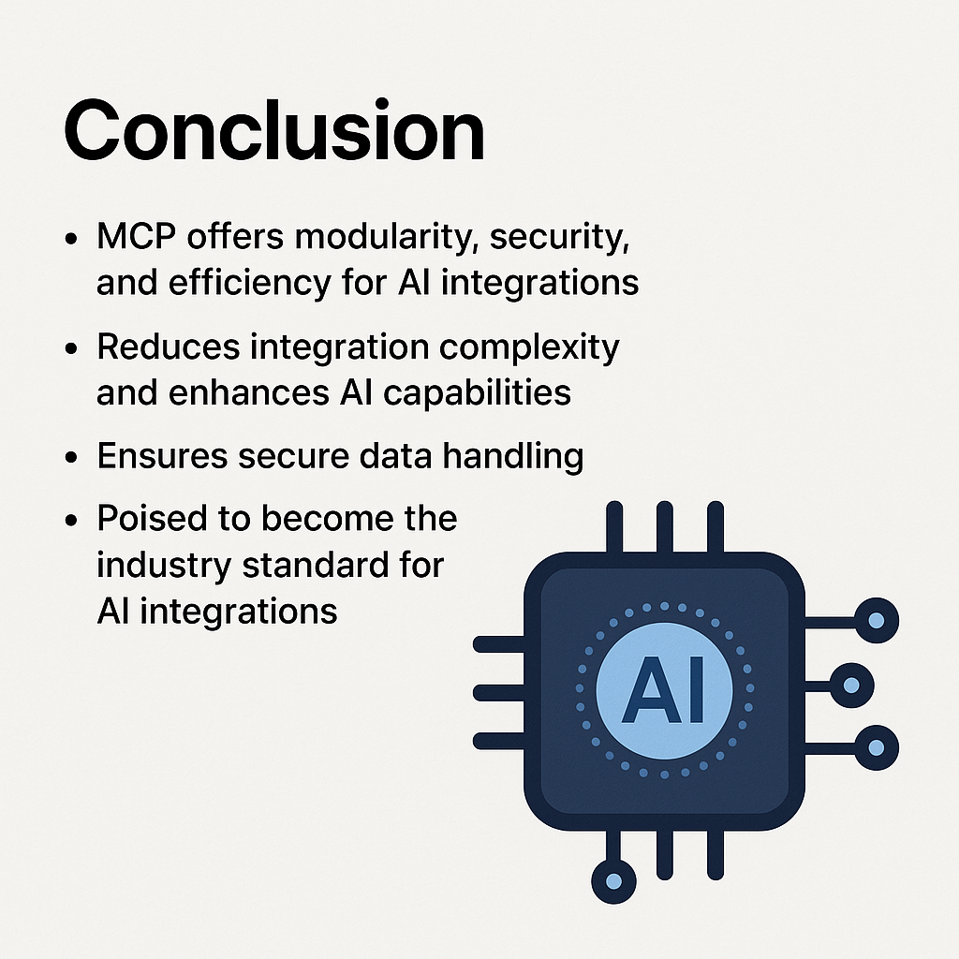
Notes:
In summary, MCP’s modularity, security, and efficiency make it ideal for AI integration.
Its modular design simplifies integration, boosting overall AI application capabilities.
With a strong emphasis on secure data handling, MCP ensures data protection, which is crucial for trust and compliance.
Thanks to these strengths, MCP is well-positioned to become the industry standard for AI integrations, defining best practices and setting new industry norms for leveraging AI efficiently and securely.

